Slide 1


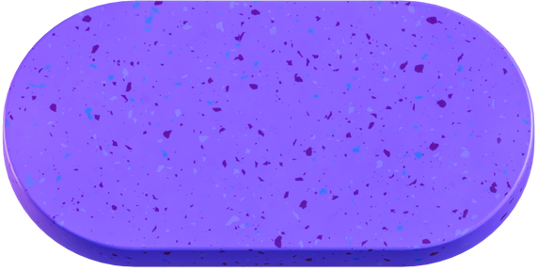
AI/ML-BASED CYBER THREAT DETECTION IN NETWORK TRAFFIC
Intel Unnati Industrial Training – AI/ML for Networking
Team Members:
1.Mohana Priya
2.Jahnavi
3.Inbaa
4.Sangeetha
5. Mowriya

Slide 2
Problem Statement
Solution Summary
OBJECTIVE:
To build a machine learning pipeline that can detect malicious network activity using real-time traffic data.
Developed a machine learning model to classify network threats in real time
Built a Flask web application for interactive predictions
Processes uploaded CSV files and predicts threat labels using a pre-trained model
Displays the prediction results on a user-friendly web interface
KEY GOALS:
Analyze labeled packet capture data (CICIDS 2017).
Train an ML model to classify threats.
Create a real-time prediction system for new network activity.

Slide 3
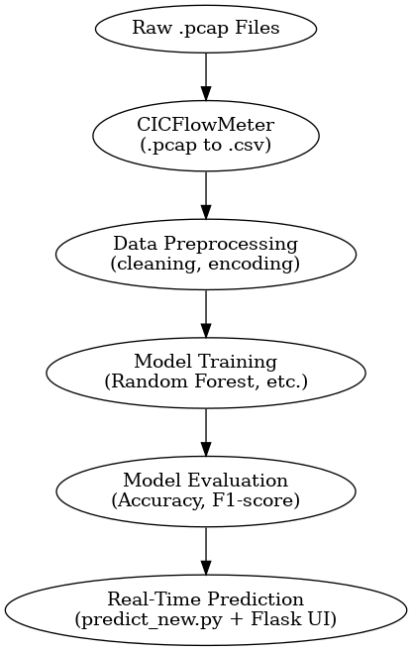
Architecture Flow
Flow Chart
The architecture begins with raw network traffic (.pcap) files, which are converted into structured CSV format using CICFlowMeter. This data is then preprocessed, used to train a machine learning model, evaluated, and finally integrated into a real-time Flask-based prediction system.
Tools Used
Python, Scikit-learn
Flask (for real-time prediction UI)
CICFlowMeter (for CSV conversion)
Pandas, NumPy, Matplotlib

Slide 4
Dataset Description
Issues & Fixes
S.No | Issue Faced | Fix Applied
1 | Prediction shape error | Used .ravel()
2 | Missing features | Column alignment
3 | No result display | Defined decoded_labels
4 | File not found | Corrected file path
5 | Missing imports | Added libraries
6 | File undefined | Fixed variable usage
Dataset Used: CICIDS 2017
Source: Canadian Institute for Cybersecurity
Size: ~1.6 million records
Classes:
Benign
PortScan, DDoS, Bot, Web Attack, Infiltration, etc.
Features:
Flow-based metrics like Flow Duration, Packet Length, Flow Bytes/s, etc.
Tools Used: CICFlowMeter to convert .pcap to .csv format

Slide 5
Model Design & Features
Preprocessing:
Removed null/NaN/infinite values
Label Encoding of threat types
Feature scaling using StandardScaler
Model Trained: Random Forest (best performance)
Others Tried: Logistic Regression, Decision Trees, Gradient Boosting
Selected Features:
Flow Duration
Fwd Packet Length Mean
Flow Bytes/s
Init_Win_bytes_forward
and others…

Slide 6



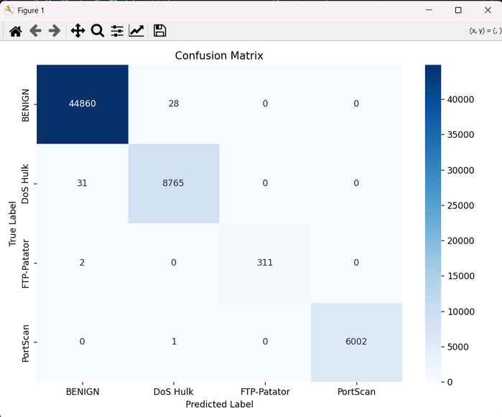

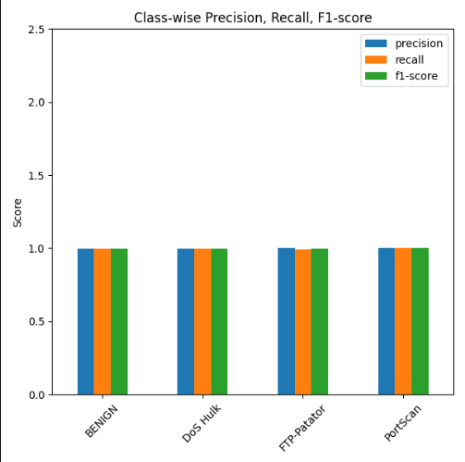
Results & Visuals
Accuracy: ~99.3%
Precision/Recall/F1: High across classes
Confusion Matrix: Shows strong classification ability

Slide 7
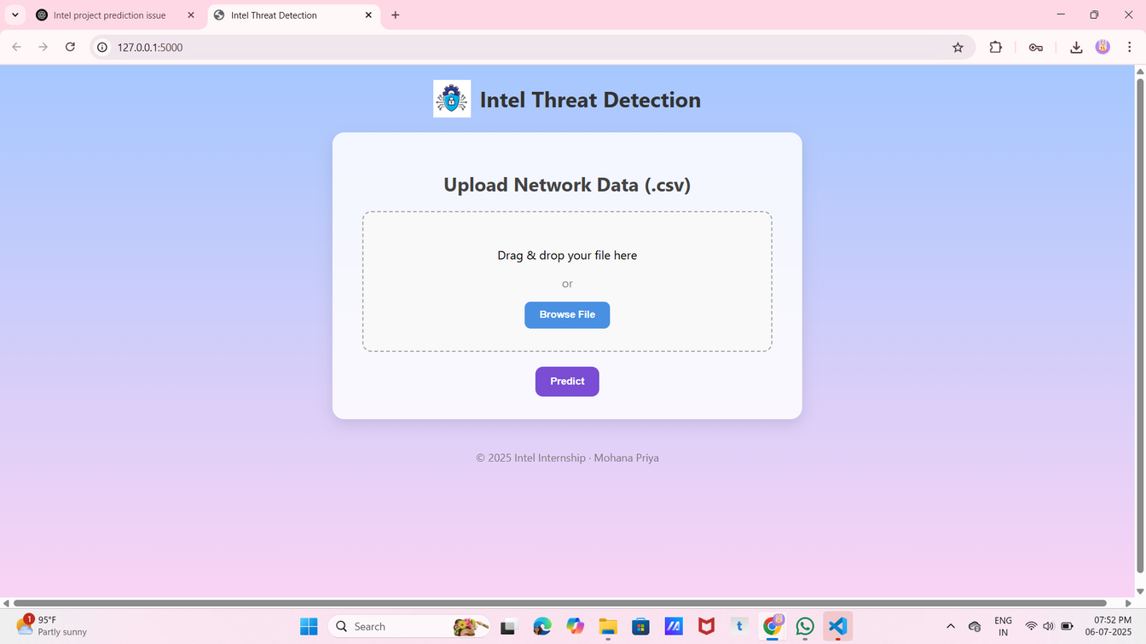
Real-Time Prediction Demo
Backend: predict_new.py script
Loads trained model + encoder
Accepts new flow data (.csv)
Predicts threat type instantly
Frontend: Flask Web UI
Upload new network file
Get instant threat classification
Simple and responsive design

Slide 8
Team Roles & Contributions
Name | Contribution
Mohana Priya | Real-time prediction module, Flask UI, model integration
Inbaa | Data cleaning, preprocessing, feature engineering
Mowriya | Model training, hyperparameter tuning
Jahnavi | Evaluation metrics, graph plotting
Sangeetha | Documentation, PPT

Slide 9


Learnings & Future Scope
Learnings:
Applied ML to a real cybersecurity dataset
Understood end-to-end ML pipeline
Built and deployed a real-time Flask app
Future Scope:
Deploy as background network monitor agent
Use deep learning for more complex traffic
Handle encrypted packets and evolving threats

Slide 10




THANK YOU!
COLLEGE NAME
PROJECT REPOSITORY
SUBMITTED TO
J N N Institute of Engineering
Intel Unnati, July 2025
Link

